Slide 1

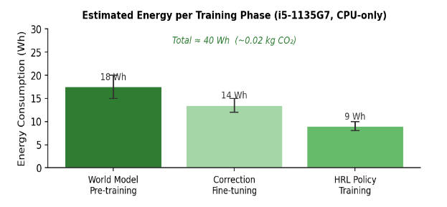
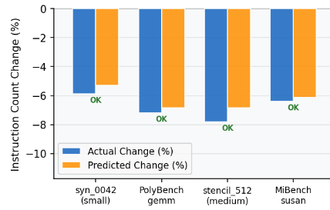
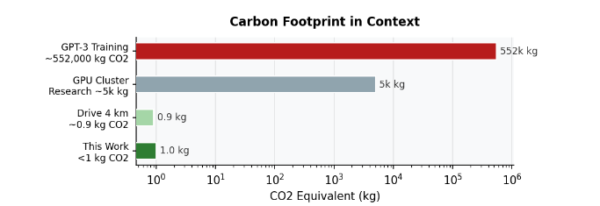
Multi-Agent Hierarchical Reinforcement Learning for Compiler Optimization
Tarun Nagarajan, 24CSB0A79
PROJECT BASED LEARNING, COMPILER DESIGN

Slide 2
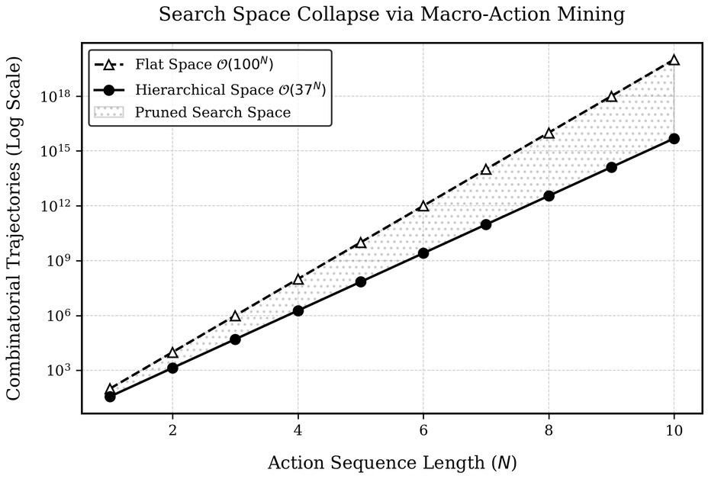
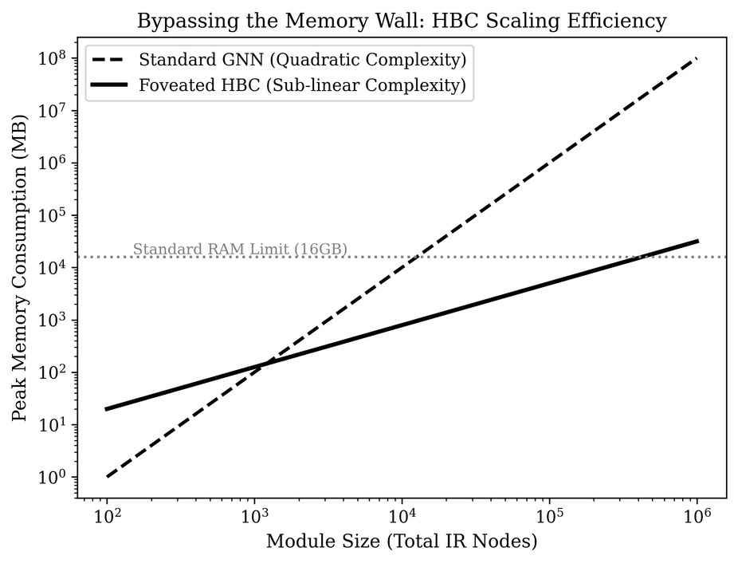
Background
Phase-Ordering Crisis
Catastrophic Instructions
Finding the optimal sequence of compiler transformation passes (e.g., inlining, loop unrolling, vectorization) is mathematically NP-Hard.
Passes are non-linear and antagonistic. A pass that helps one loop can cause catastrophic instruction cache thrashing in the next.
The Scaling Bottleneck
Memory Explosion
Standard Graph Neural Networks (GNNs) are only built for small kernels (50–100 nodes).
Processing whole-module industrial codebases like SQLite (131,000 nodes) creates an O(N2) memory explosion.
  Limited Computational Resources
  Ability to Train an Agent with both Performance and Edge AI capabilities
  Scaling to Industrial Level Code Benchmarks
  Keeping all Computation Local to ensure Privacy First AI

Slide 3


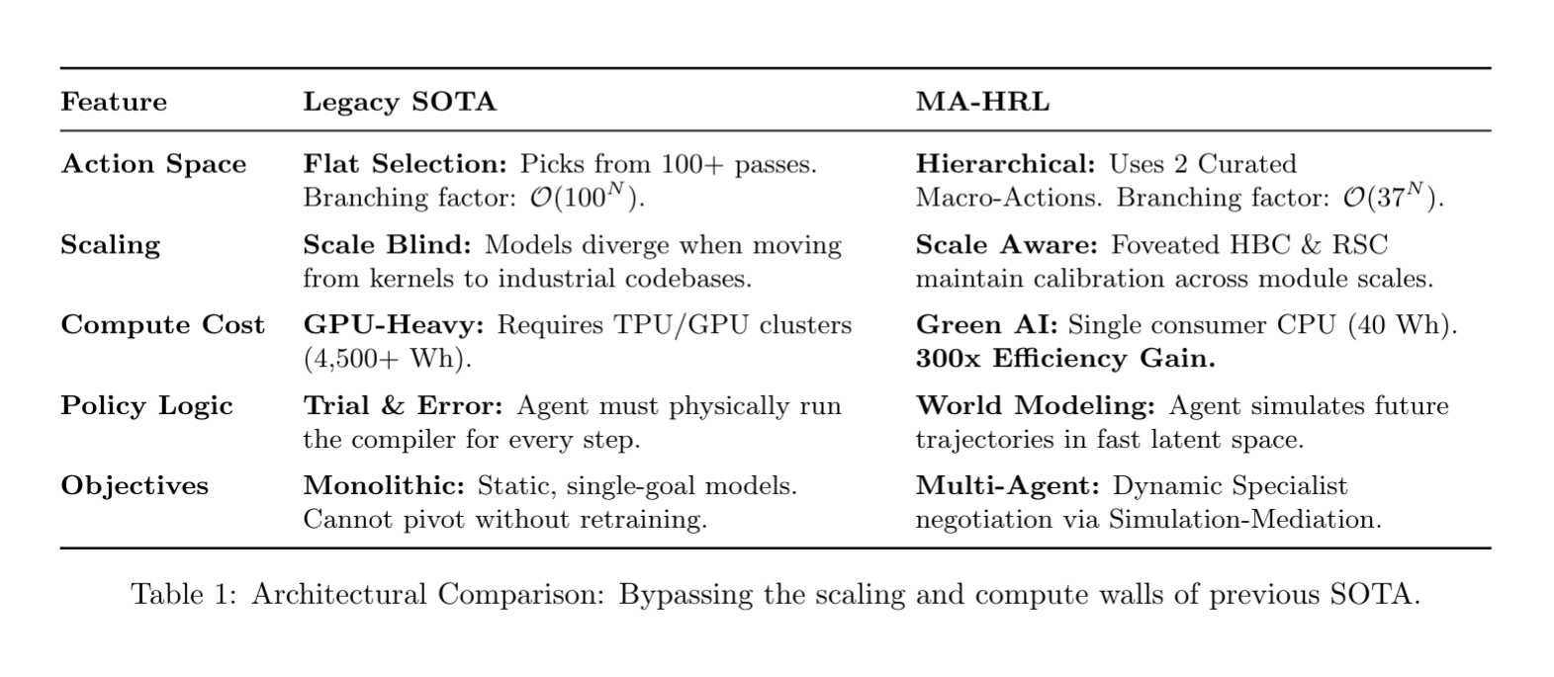
Previous Work

Slide 4
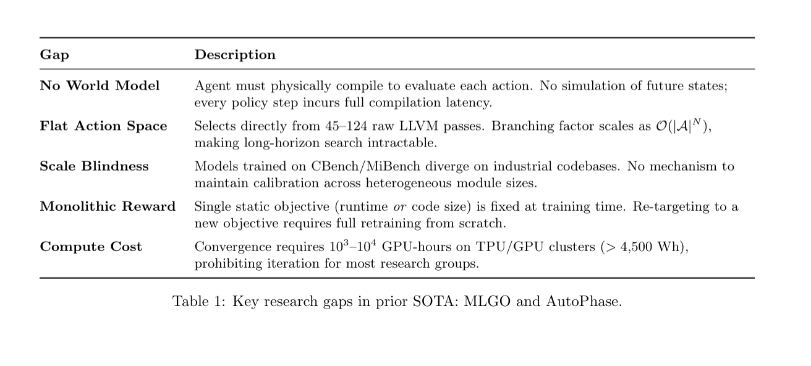
Previous Work

Slide 5
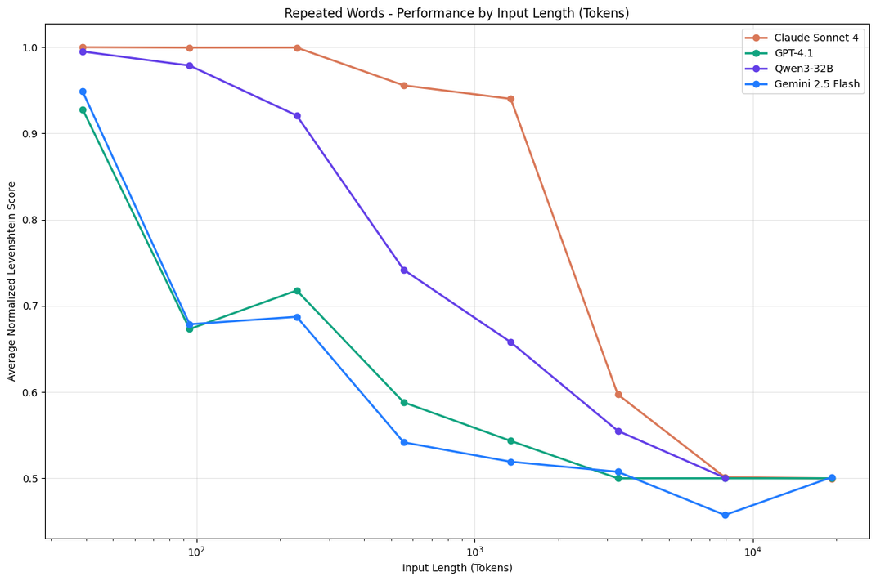
Why LLMs are NOT the Solution.
LLMs can assist compiler optimization workflows, but can never replace them.
Non-Deterministic Objective Optimization
Compiler pass interactions are non-linear; confident but incorrect suggestions can degrade performance or increase code size.
Lack of Verifiable Action Consequence Modeling
Compiler optimization requires “if pass X then metric Y changes by Z%” reasoning, which needs a calibrated world model + measurement
Hallucinations in Low-Level Decision Making
We need explicit optimization targets (runtime, size, energy) under constraints; LLM outputs are not reliably objective-aligned.
Also, you’d have to load an LLM into memory to run inference, which means that you’d use the same computation for a ‘Hello World’ program, as you would for a normal code snippet. There’s no adaptive computation here.

Slide 6
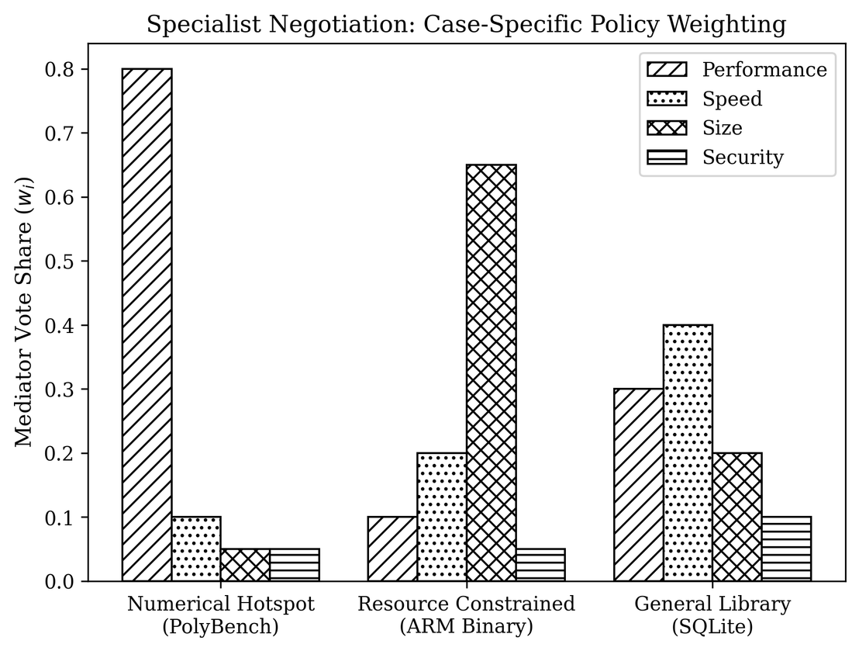
Optimization Objectives
The performance of an optimizing agent depends on the features you feed to the model during training. This also shapes different decision making strategies under varied conditions.
Runtime Performance Objective (Speed)
Minimize end-to-end execution time versus strong compiler baselines (-O2, -O3).
Code Size, Memory Footprint Objective (Embedded Efficiency)
Reduce text size and memory pressure for constrained targets without breaking functional correctness.
Energy-Aware Objective (Efficiency per Task)
Minimize energy-per-execution using runtime-linked energy estimates/proxies.
The optimizer is not single-metric; it is trained to make target-aware tradeoffs across speed, size/memory, and energy, depending on deployment needs.

Slide 7
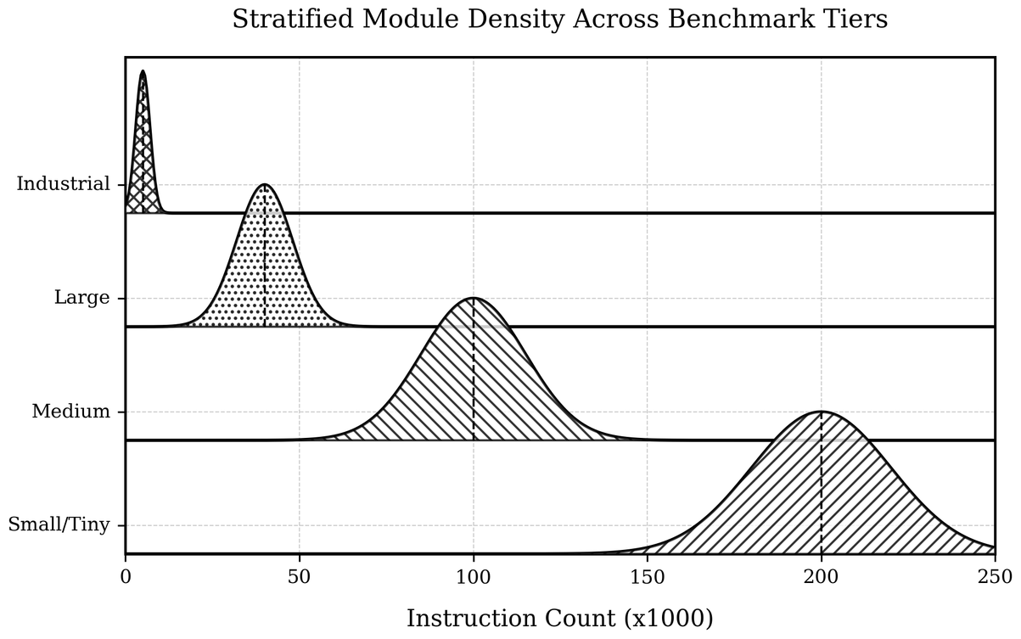
Benchmark Suite and Data Coverage
The data makes the model. Training on simple, template generated code snippets will result in over-fitting and model collapse. Competing in real-world benchmarks requires code that matches that standard.
Multi-Source Benchmark Composition
The dataset combines synthetic kernels, PolyBench-style numerical workloads, MiBench/system workloads, and industrial-scale code.
Synthetic programs provide controlled structure variation (loops, branches, memory patterns, recursion), enabling broad pattern exposure.
Real-world modules (e.g., large compression/parser/database-style code) inject practical complexity and non-ideal IR patterns.
Evaluation subsets are kept representative across categories so reported gains are not biased by one easy stratum. Transition data records action, graph/state context, and metric deltas (instruction/size/structural/runtime-related signals).

Slide 8
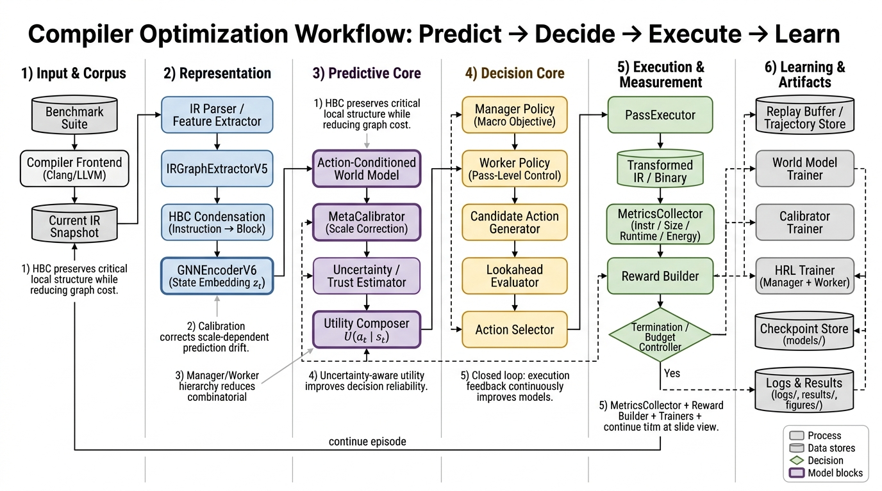
System Architecture and Workflow

Slide 9
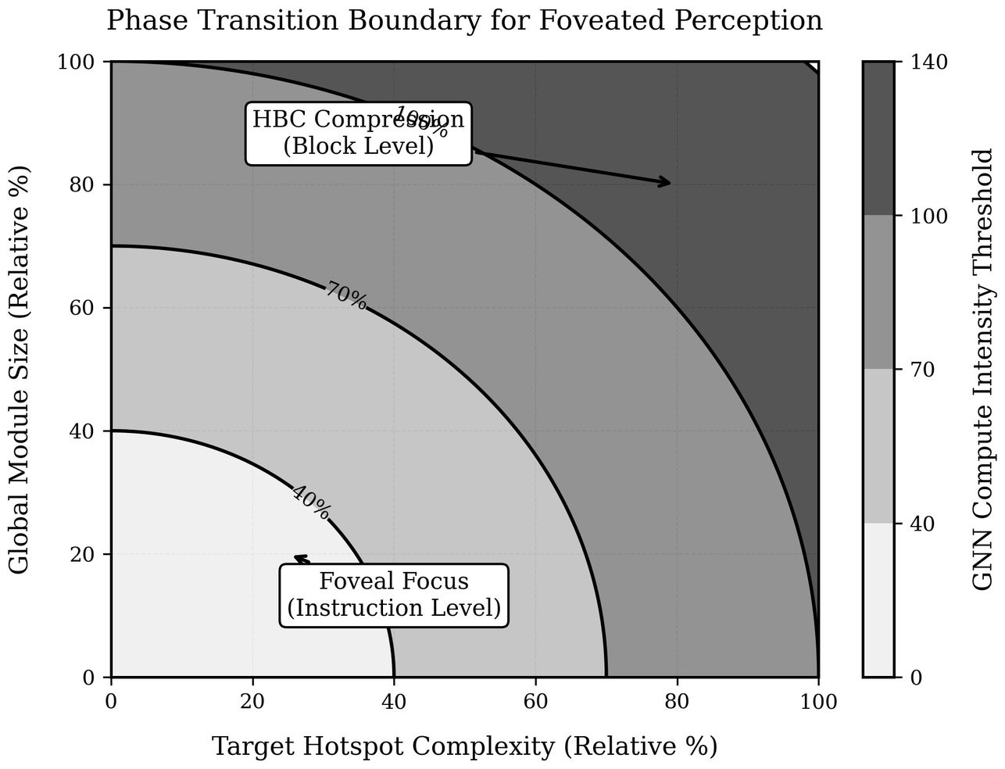
IR Representation and Foveation
Hierarchical Block Condensation (HBC) + Foveal Refinement
We first condense instruction-level regions into block-level summaries for global reasoning, then re-expand and focus on selected local regions for precise decision making. This gives a global+local hybrid view.
IR as a Multi-Relational Graph (Foundation)
Each function is converted into a graph where nodes encode instructions/basic blocks and edges encode control-flow/data dependencies. This preserves compiler-relevant structure better than flat token sequences.
Foveation = Selective High-Resolution Processing
Instead of uniformly processing the whole graph at full detail, we identify high-impact regions (hot/basic blocks, dependency-dense neighborhoods, unstable optimization zones) and allocate fine-grained compute there.

Slide 10
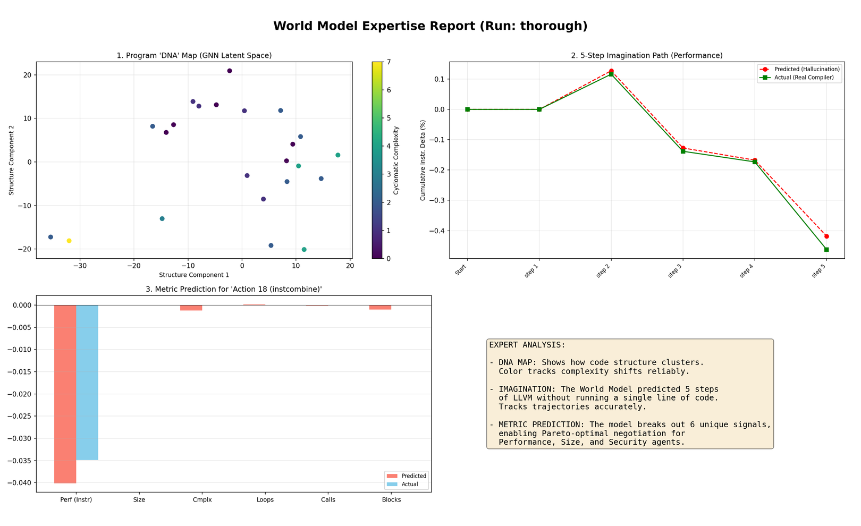
World Model: Predictive Planning
Know the Outcome before Execution.
The world model acts as a fast surrogate for expensive compiler execution. Given the current foveated program state and a candidate optimization action, it predicts how key objective signals will change, such as runtime proxy, code size proxy, and structural quality indicators.
To make those predictions reliable across very different program scales, a calibration stage adjusts the raw model outputs. This is important because the same pass can behave very differently on a tiny
kernel versus a large, dependency-heavy function, and uncalibrated predictions can mislead planning

Slide 11
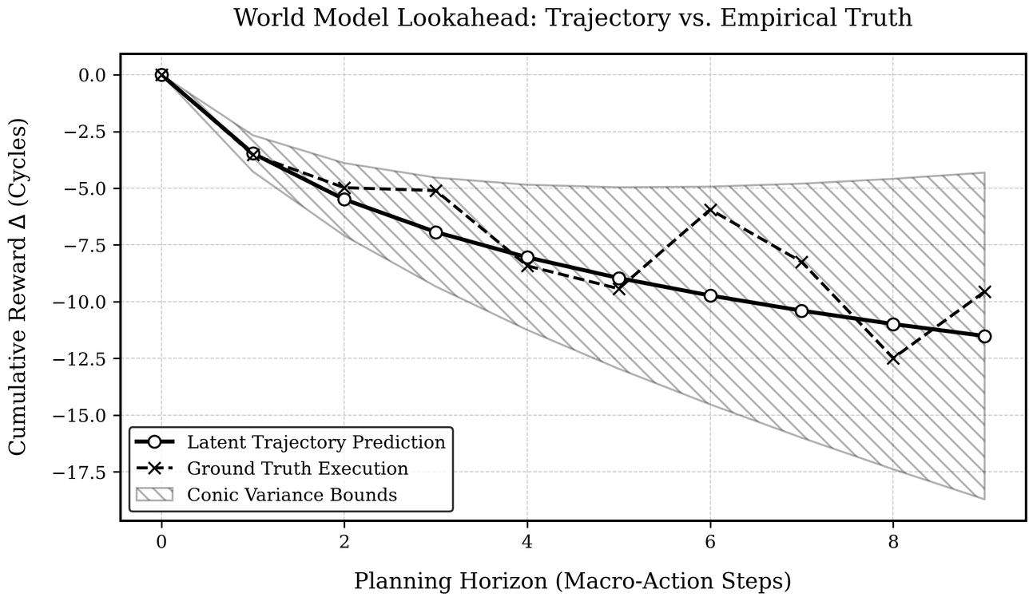
Performance Agent
Objectives
The performance agent is optimized for runtime improvement and is trained to push execution speed beyond standard compiler baselines. Its reward shaping strongly prioritizes cycle/runtime gains while discouraging unstable action sequences that create regressions.
Hierarchical Control
It uses hierarchical control: a high-level manager sets strategic intent, and a lower-level worker selects or refines concrete pass choices. This decomposition helps long-horizon optimization because it separates “what to optimize now” from “which exact pass should be applied next.”
Partner for the World Model
Combined with world-model lookahead, the performance agent can focus on high-confidence, speed-oriented trajectories rather than random trial-and-error. The result is typically stronger throughput improvements with better consistency across benchmarks.

Slide 12
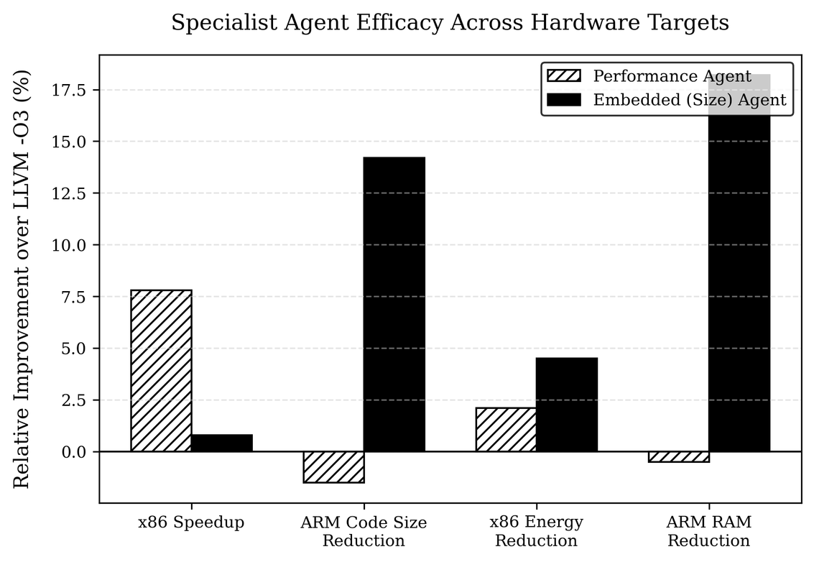
Embedded Agent: Green AI
Objectives
The embedded agent is designed for resource-constrained targets where binary size and energy matter as much as, or more than, raw speed. Its objective function emphasizes compactness and efficiency while controlling unacceptable runtime degradation.
Respecting Memory Sensitive Constraints
Unlike a performance-first policy, this agent learns to avoid transformations that produce code bloat or energy-unfriendly behavior. It prefers optimization paths that preserve deployment feasibility for memory-limited and power-limited environments.
Specialized for Use Case
This objective specialization is the key value: instead of forcing one universal policy to fit all use cases, the framework provides a dedicated policy for embedded constraints. That makes optimization outcomes more predictable and practically useful for edge deployment.

Slide 13
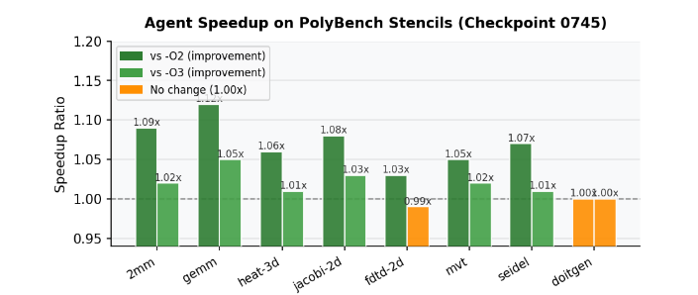
Performance Agent: Results

Slide 14
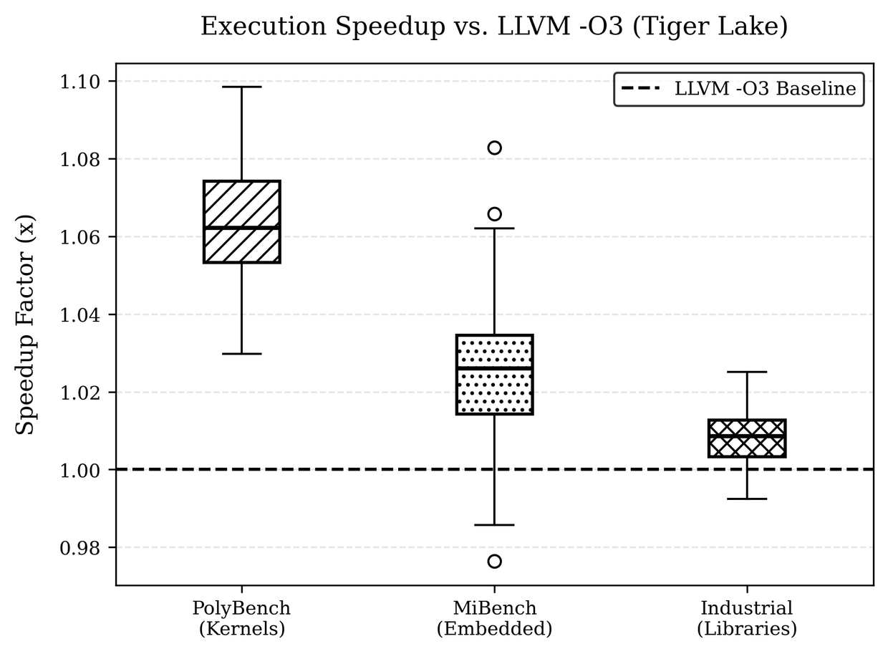
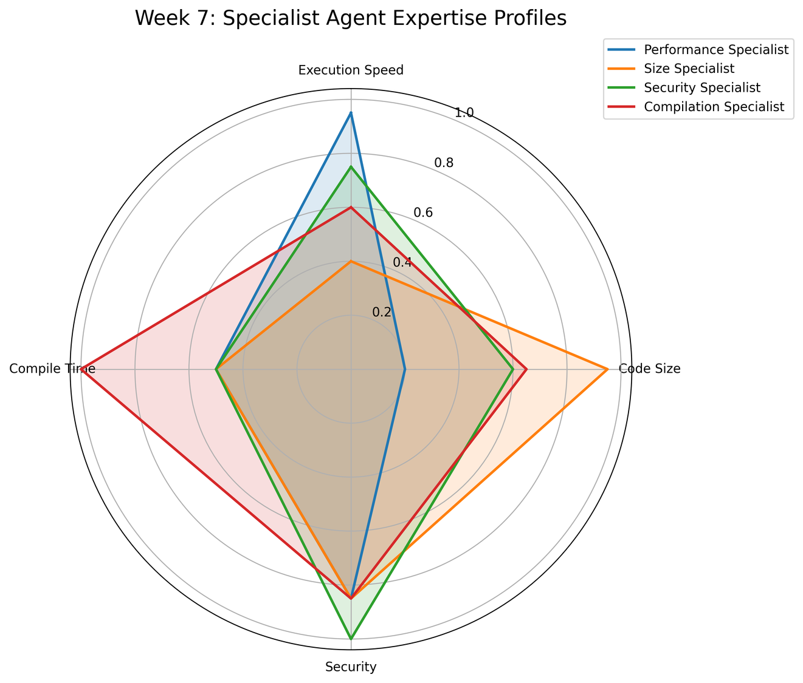
Performance Agent: Results

Slide 15
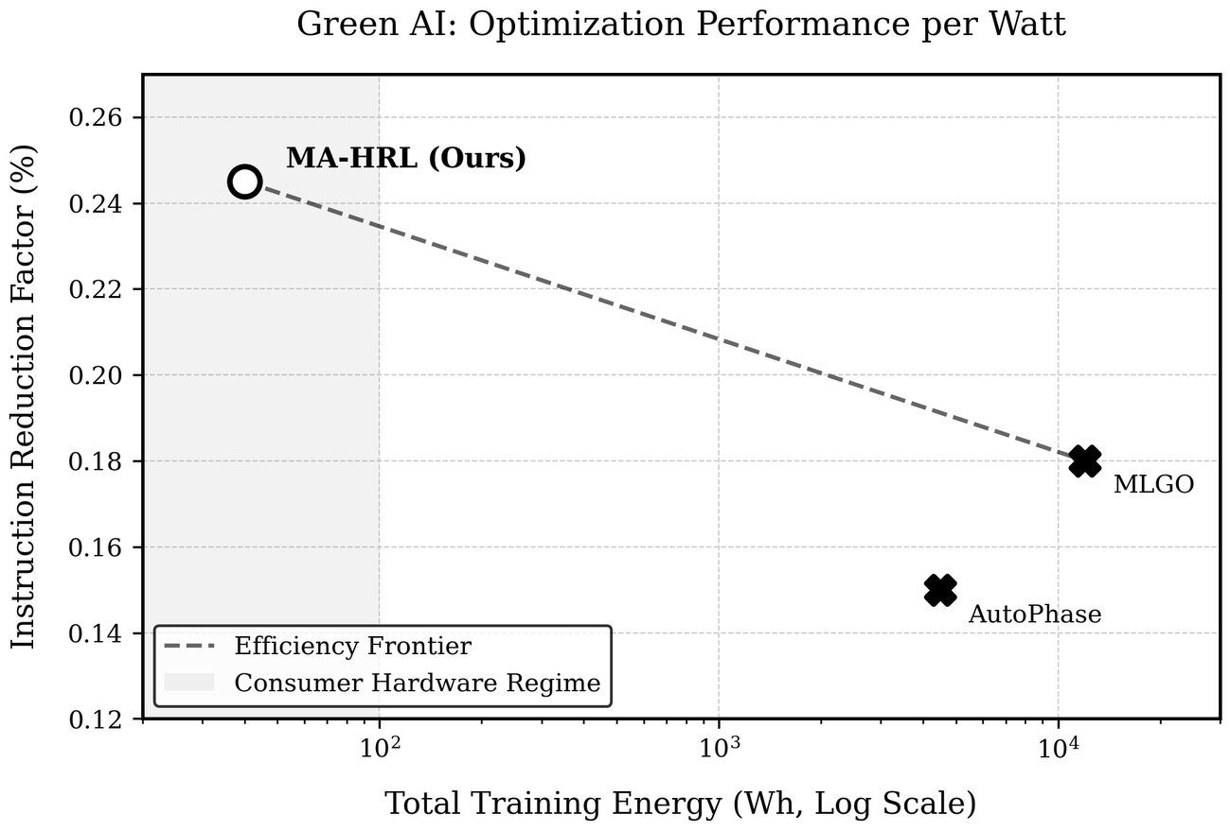
Embedded Agent: Results

Slide 16
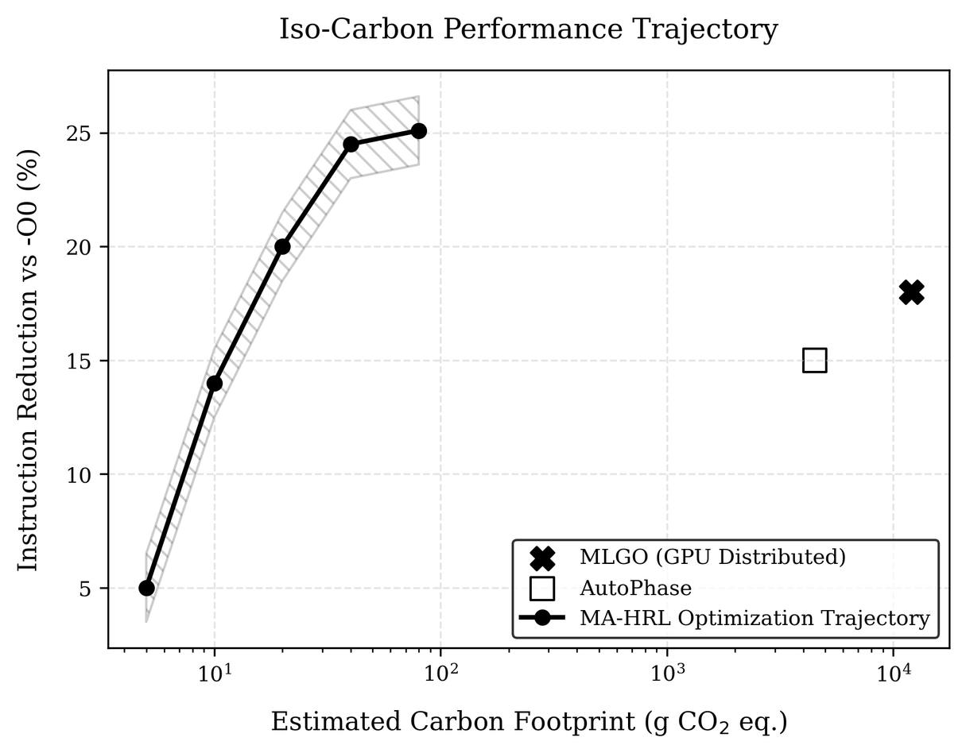
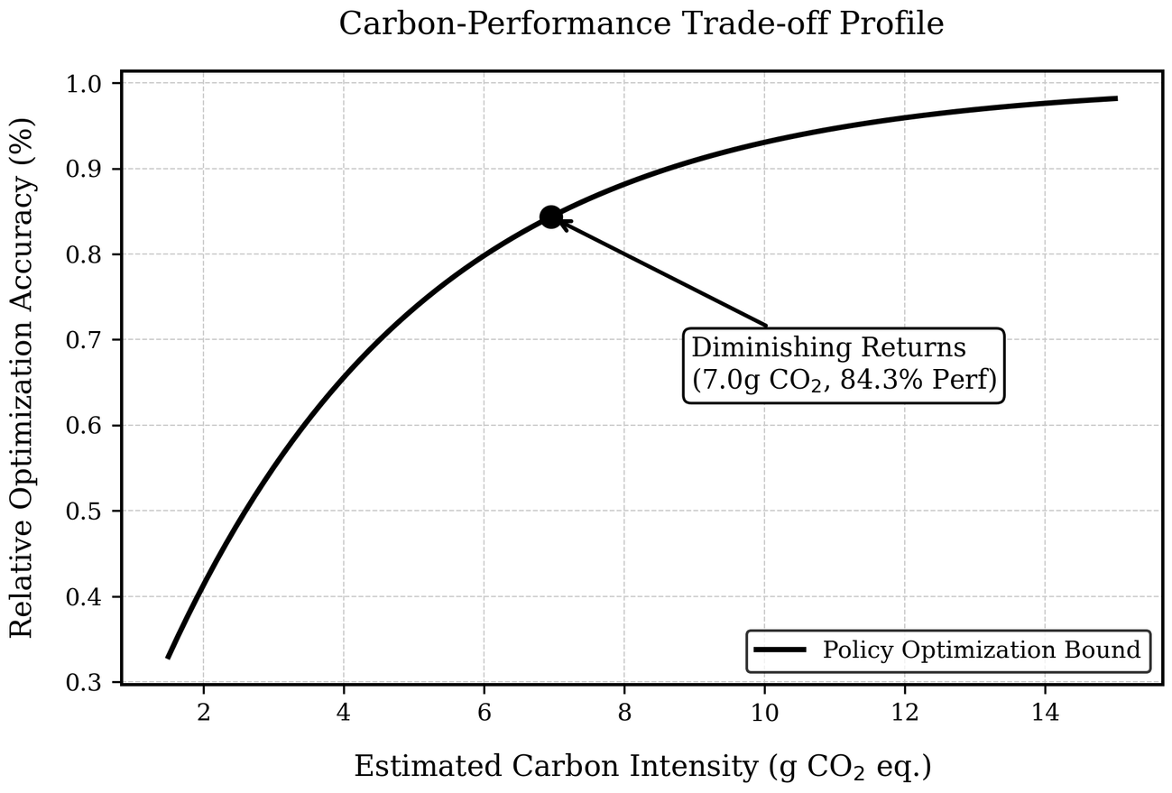
Embedded Agent: Results

Slide 17
Embedded Agent: Results

Slide 18
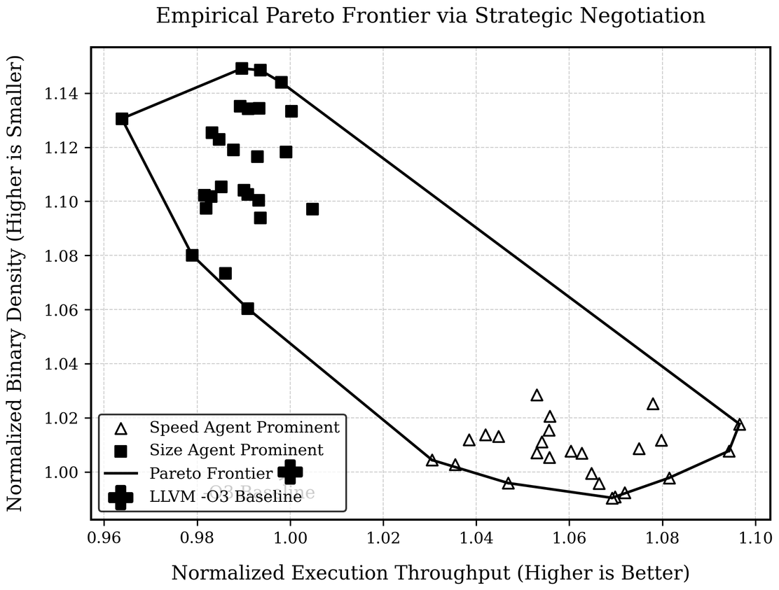
Conclusion, Future Work.
The next step is to make the framework more adaptive and deployment-ready. I plan to improve cross-platform measurement fidelity (especially runtime/energy), expand benchmark diversity to include broader real-world workloads, and strengthen uncertainty calibration for better robustness on out-of-distribution programs.
Beyond that, I aim to add dynamic policy routing that automatically selects or blends optimization strategies per program family, moving toward a general-purpose learned compiler optimizer that is both high-performing and trustworthy in production settings.

